Slide 1
LOW POWER CONSUMPTION FLASH ADC USING TIQ COMPARATOR
Guide: Dr. ramya H.r.
Presented by:
adhiraj kar (1ms20et002)
Eish raj (1ms20et020)
Souhardya dey (1ms20et051)

Slide 2
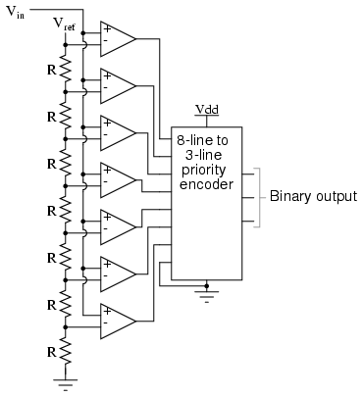
PROBLEM STATEMENT
Conventional ADCs use:
Large resistor network.
2^{n}-1 no. of comparators.
External power supply for reference voltage.
This increases the complexity of
the circuit, power consumption
as well as area.

Slide 3
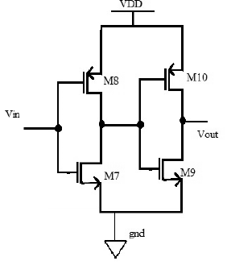
INTRODUCTION
Uses TIQ technique ,consisting of,
2 cascaded CMOS inverters
Replaces large resistor ladder network and comparators

Slide 4
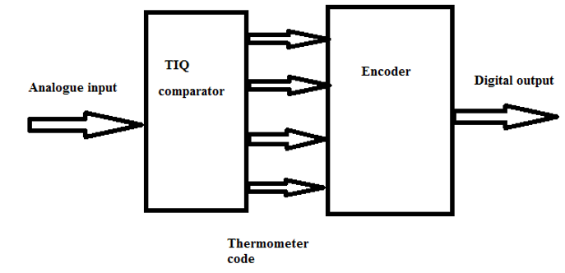
METHODOLOGY
TIQ
Encoders
Wallace tree encoder
ROM based encoder
MUX based encoder

Slide 5
TIQ
Two cascaded inverter makes a one TIQ comparator
Comparing analog input with switching voltages provides thermometer code

Slide 6
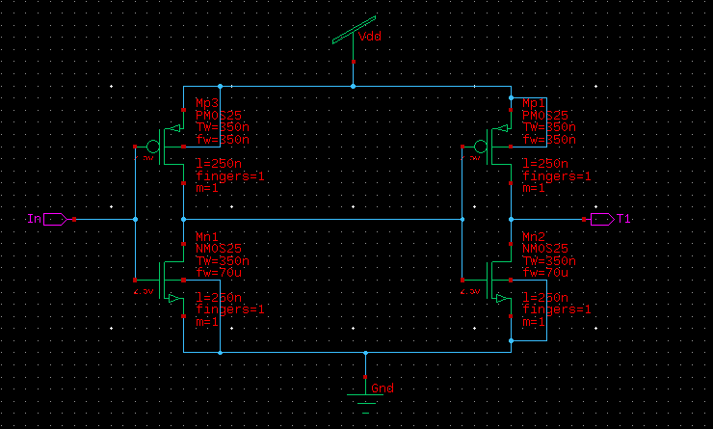
Each tiq schematic structure

Slide 7
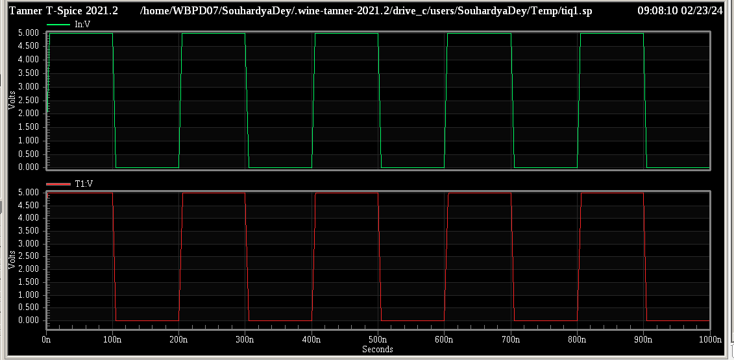
Graph of each tiq comparator

Slide 8
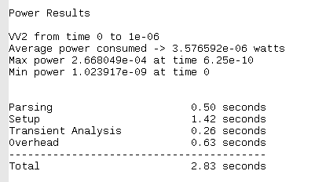
Power of each tiq comparator

Slide 9
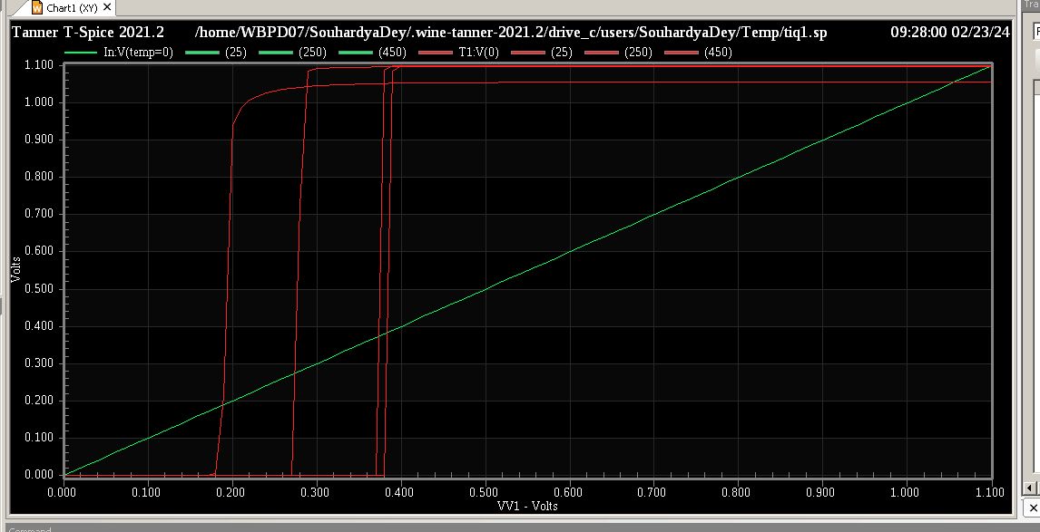
Different temperature affecting each tiq

Slide 10
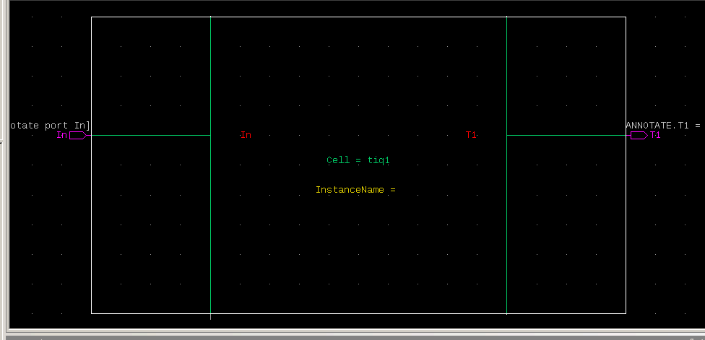
Each tiq symbolic structure

Slide 11
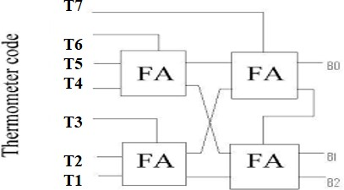
Wallace tree encoder
One approach to convert thermometer code to binary code is Wallace encoder.
This encoder is built with full adder cells.

Slide 12
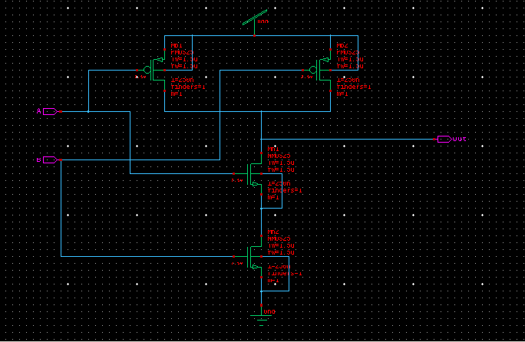
Two input nand gate schematic diagram

Slide 13
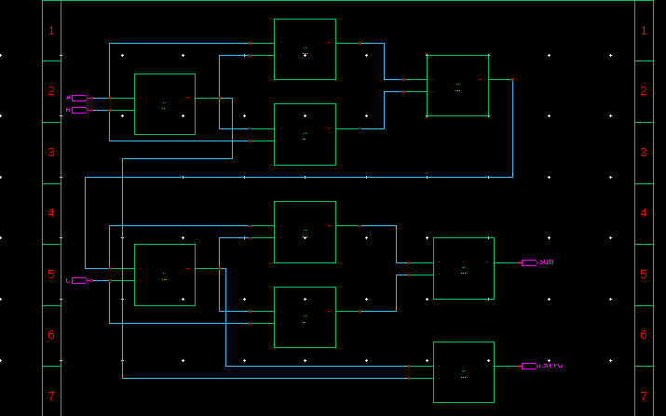
Full adder using nand gates schematic

Slide 14
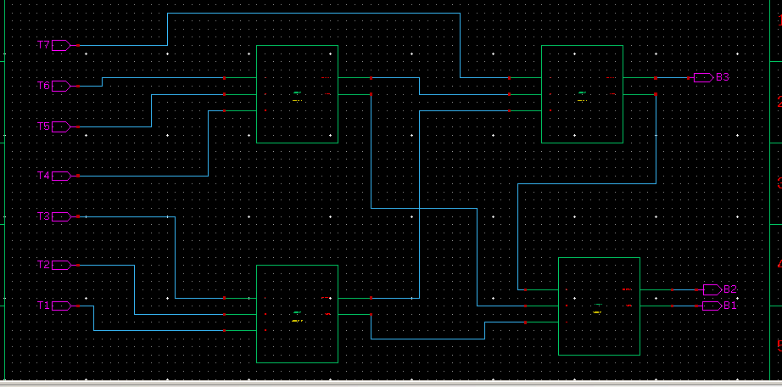
Wallace tree encoder schematic

Slide 15
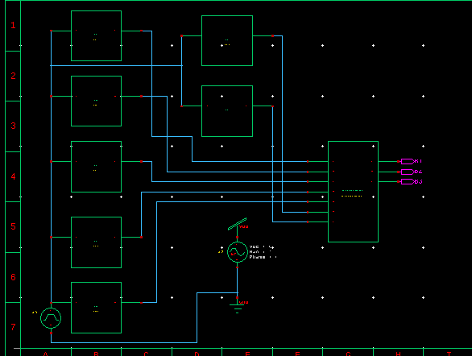
Wallace tree encoder with tiq

Slide 16
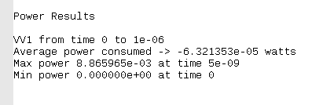
Power consumed with Wallace encoder

Slide 17
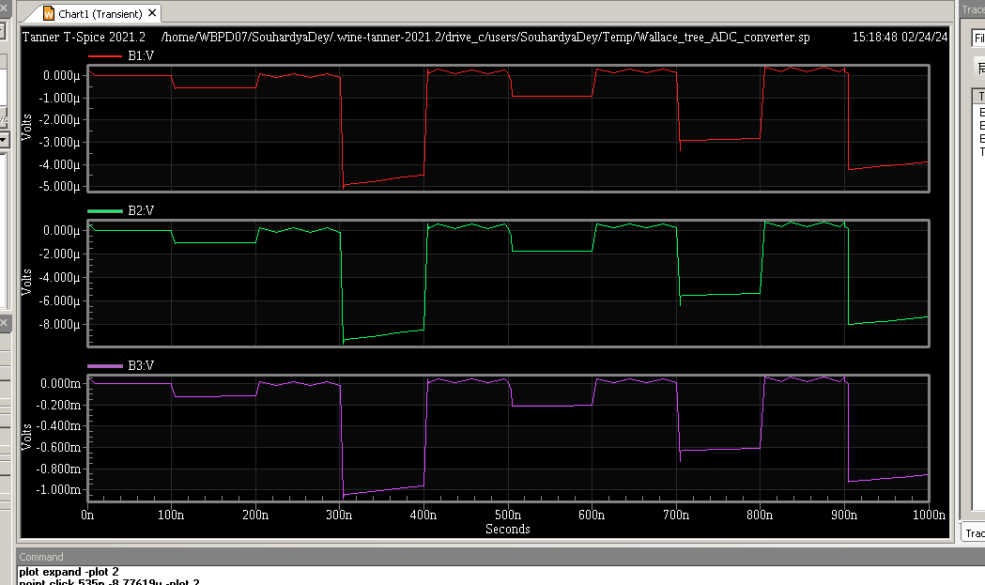
Flash adc output using Wallace tree

Slide 18
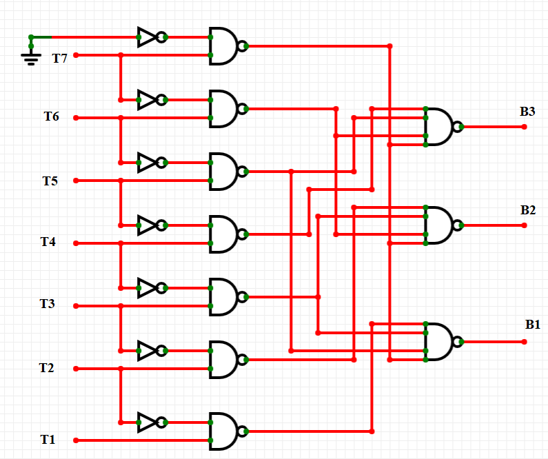
Rom based encoder
ROM based encoder is composed of two stages:
Two input AND gate
Four input NAND gate

Slide 19
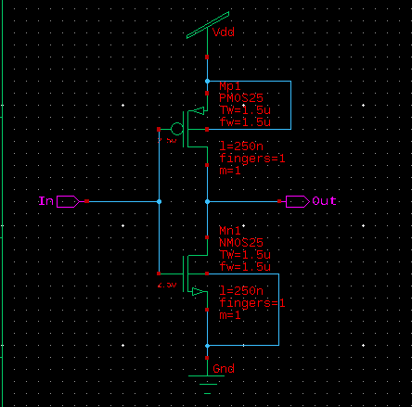
Inverter schematic diagram

Slide 20
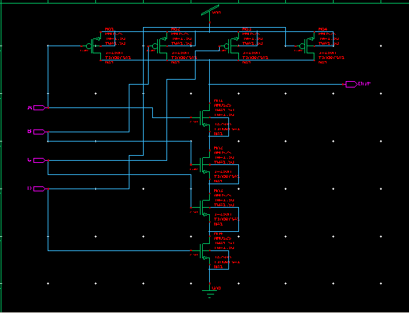
4 input nand gate schematic

Slide 21
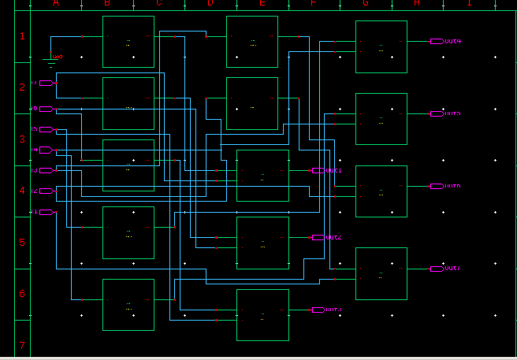
Rom encoder part 1 schematic

Slide 22
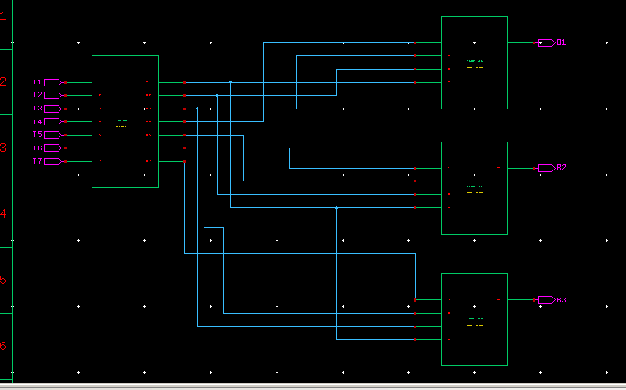
Rom encoder part 2 schematic

Slide 23
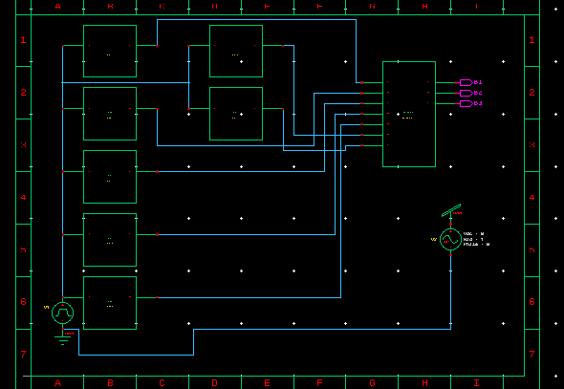
Rom based encoder with TIQ

Slide 24
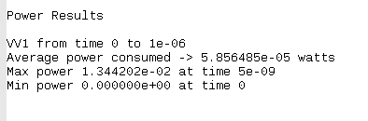
Power consumed by Flash ADC rom based

Slide 25
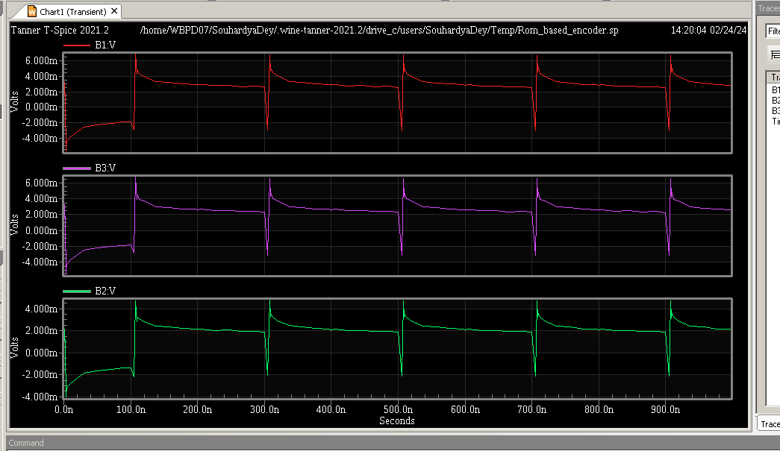
Rom based flash adc graph

Slide 26
Mux based encoder
When v4 is low at logic 0,input v2 passes its data through the MUX circuit to the output while input v6 is blocked.
When v4 is high at logic 1,input v6 passes data to output and v2 is blocked

Slide 27
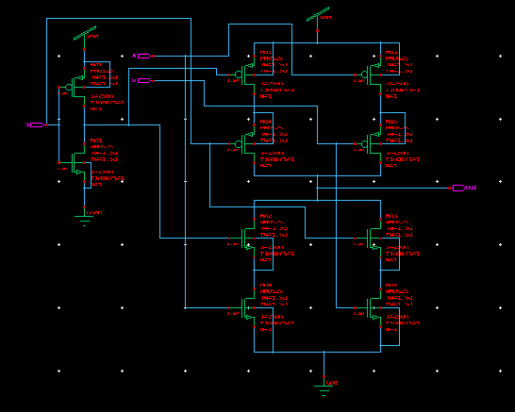
2:1 mux schematic

Slide 28
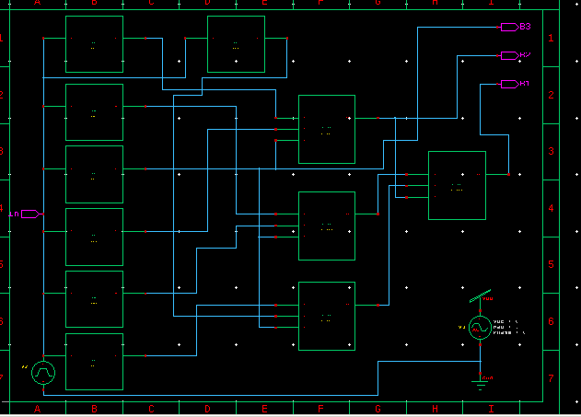
Flash adc with 2:1 mux encoder

Slide 29
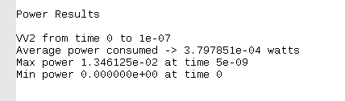
Power of flash adc using 2:1 mux encoder

Slide 30
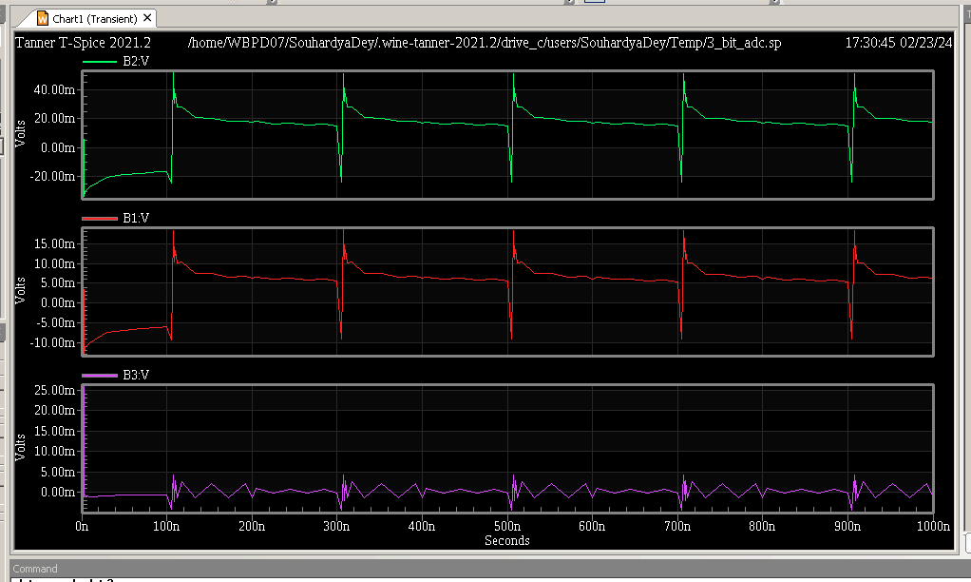
Tiq flash adc using 2:1 mux

Slide 31
REFERENCES
Kalpana Chaudary;”3bit flash ADC for 90nm technology”
Mamta gurjar;”3bit flash ADC for 45nm technology”
Sireesha, R.; Kumar, A., "Design of low power 0.8V Flash ADC using TIQ in 90nm technology”.
Gulrej Ahmed, Rajendra Kumar Baghel “6 bit flash analog to digital converter using variable switching voltage CMOS comparator”.
Megha R, Pradeepkumar K A “Implementation of low power flash ADC by reducing comparators”.
T.S.Lakshmi and A.Vireni ;”Low powerencoder for 5-bit flash ADC”

Slide 32
THANK YOU

